Slide 1
Maintaining and increasing proficiency in- and outside the classroom using IT tools:
a look at electronic flashcards, serious gaming and app-based military wordlists
Kristian Kolding, Kåre Kildevang-Jakobsen & Allan Juhl Kristensen
Dept. of Languages and Cultures
Royal Danish Defence College (RDDC)

Slide 2
BILC SEMINAR
Technology and Language Learning aT RDDC
Demonstrate ways that the Dept. of Languages and Cultures is trying to use technology to enhance language learning in the face of:
a dictate that learning, including language learning, increasingly take place as blended and distance learning;
a general requirement to acquire, maintain and improve L2 MIL proficiency throughout military careers;
a need for easily acessible learning materials for self-directed study;
a professional conviction that vocabulary matters in SLA.
Notes:
Across DAF: 50% of learning as blended/distance
English language skills as part of job descriptions, competence profiles and training programmes (life-long learning, take repsonsibility for own learning)

Slide 3
BILC SEMINAR
Vocabulary and SLA
Increased attention within Second Language Acquisition (SLA) teaching and research to the relevance and importance of vocabulary/lexis since the mid-90s (Coady & Huckin (1997); Ellis (1997); Lewis (1993)):
‘…the ability to refer to concrete and conceptual entities is as fundamental to language as is the capacity provided by grammar to relate such entities to one another. Knowledge of a language [in our case the military domain] demands mastery of its vocabulary as much as of its grammar…’ (Wilkins, 1974)
Notes:
Functional (L2) & Professional/conceptual (L3) – do so better…
Danish AF personnel L2 upwards – expand vocab: fluency, precision, incision
Latter based on studies in and experience of the role and value of vocabulary in foreign/second language learning.
Coady, J. & T. Huckin (1997). Second Language Vocabulary Acquisition: A Rationale for Pedagogy.
Ellis, N. C. (1997). ‘Vocabulary acquisition: Word structure, collocation, grammar, and meaning’.
Lewis, M. (1993). The lexical approach: The state of ELT and the way forward.
Wilkins, 1974, Second-language Learning and Teaching)

Slide 4
BILC SEMINAR
Vocabulary and SLA cont’d
Vocabulary in the systemic lexical sense of words, phrases, chunks, collocations, formulaic sequences etc. is crucial to both communication and comprehension in a military context (cf. STANAG 6001), including interpreting and translation.
‘acquisition of a word’s semantic and conceptual properties, and the mapping of word form labels onto meaning representations, result from conscious (or explict) learning processes.’ (Ellis, 1997)
Vocabulary needs to be explicitly taught and learned (intentional/incidental); it will not develop quickly enough through simple exposure to written or spoken language. (Folse, 2004)
Notes:
Hull, capstan, bollard, fairway leads, sea control/sea denial, killer tomato
Language as more closed class (master these to go native, increase fluency and flow)
‘different aspects of vocabulary demand different acquisition mechanisms and strategies’ (Ellis, 1994).

Slide 5
BILC SEMINAR
Learners & USERS
1) Language Officer/Military Linguists programme (Arabic, Persian, Russian)
2) English courses at officer academies and junior staff course level.
3) French courses to meet operational demands for linguists and officers
4) Language support across the armed forces (reference works)

Slide 6
BILC SEMINAR
Learners’ needs
Proficiency levels: beginner-expert
Aims/ambitions: functional-expert; general-military
Circumstances: from round-the-clock language learners on Language Officer programme to part-time distance learning alongside active duty for junior officers
Motivation: from live-and-breathe languages among Language Officer cadets to junior officer’s need to pass exam to gain promotion/career progression
Notes:
(IOW: from live-in LO prg to junior staff officers having to combine work and study through distance and blended learning courses)

Slide 7
BILC SEMINAR
common ground
Overarching requirement to acquire, maintain and improve L2 MIL proficiency throughout military careers
Dictate that learning, including language learning, increasingly takes place as blended and distance learning
L2 for military purposes = a domain with its own distinct vocabulary (as well as genres, text types, idioms etc.)
L2 MIL for both study and active duty whether in staff or operations
Notes:
1) Part of job description and competency profiles; 2) 50% of courses element of BL/DL – savings, savings, savings…. 3)

Slide 8
BILC SEMINAR
Technology tools - characteristics
Demonstrate ways that mobile technologies in the shape of flashcards, e-word lists and an app game may facilitate and support the language (vocabulary) learning process for learners:
structured, learner-centred materials and resources that allow learners to work on their own and encourage a greater degree of learner autonomy;
interactive, individualised and self-directed learning;
reinforce what students are working on or have already been exposed to in the classroom;
remedial tools to help learners refresh and maintain their language proficiency;
reference tools for solving on-the-job tasks;
easily accessible and portable;
content developed for specific military purposes.
Notes:
Tools we are about to look at tie in well with new models of foreign languages didactics that underscore learner autonomy and self-directed learning, in particular in the way they make use of mobile devices. Demonstrate how new technologies may be able to facilitate and support the language learning/maintenance process for learners dotted across this wide-ranging spectrum that is united by its military purpose and aim.

Slide 9
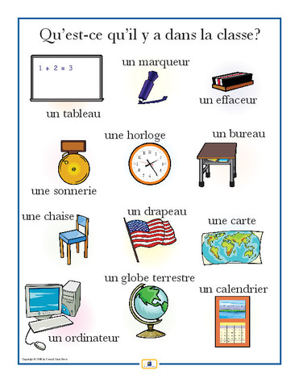
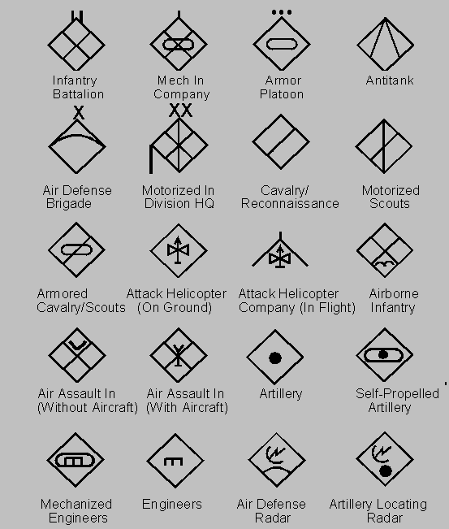
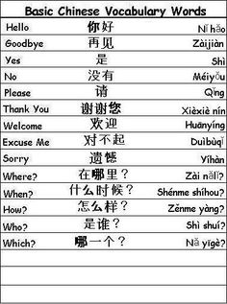
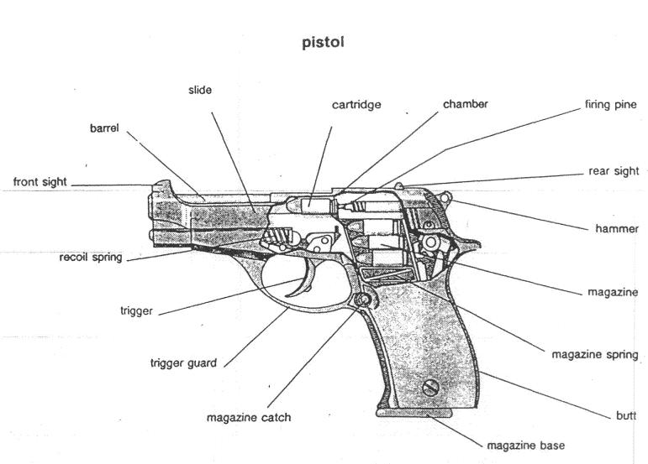
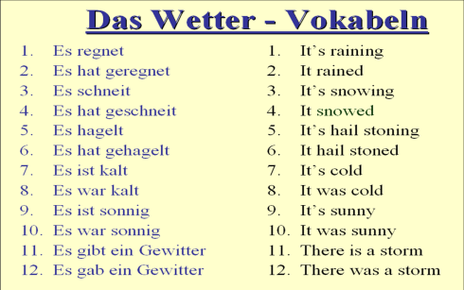
ROYAL DANISH DEFENCE COLLEGE
Department of Languages and Cultures
Notes:
Slide 1 / intro
Introduction of vocabulary through various types of word lists seem to be an integral part of many language programs. At beginner and intermediate levels language learners often work with specific lists of new vocabulary presented either through first language or together with some form of visual explanation (dual coding). At later stages vocabulary can also be presented through target language definitions, by its use in context, root meaning, structure etc. depending of the purpose of the language program. ((For instance, courses focusing on translation of military or technical language might opt for wordlists with the two relevant languages, while advanced proficiency oriented training might go with definitions and context use)).
Though we are well aware that vocabulary acquisition is a complex process where both the visual and auditory properties of a given word need to be linked with its syntactic, semantic and referential properties etc., and though we know that one acquires vocabulary by seeing, hearing, reading and using words repeatedly in different ways and contexts, it might be useful to take a deeper look at the initial baseline: namely: the word lists
Also: incidental vocab acquisition, but not focus here.

Slide 10
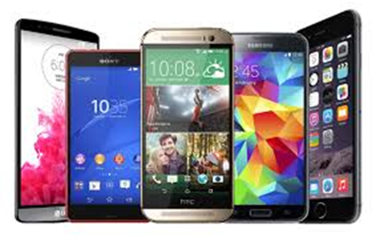
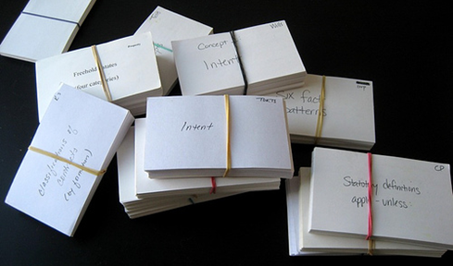
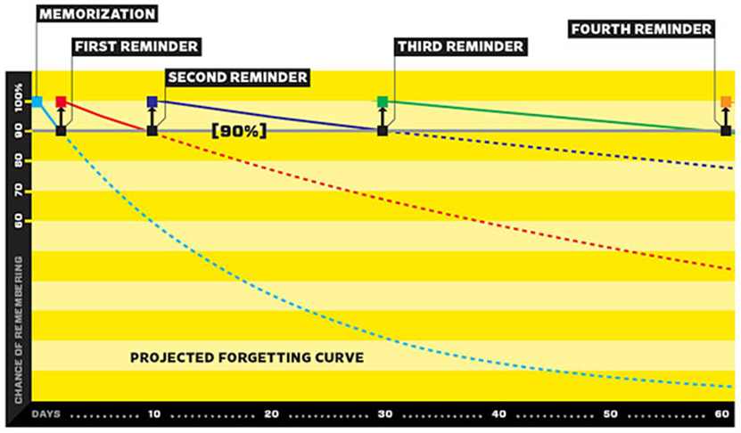
BILC SEMINAR
why Word lists?
L1 to L2 conceptualization
Learner expectations
Self directed learning
Flash cards & spaced repetition software
Repetitio est mater studiorum
Notes:
Slide 2 / intro - word lists
L1 to L2 conceptualization
Most FL learners have well established semantic and conceptual systems linked to their first language. Therefore, acquisition of a foreign language involves the direct transfer of new words into existing templates, what is also called native language transfer or mere translation. Acquiring vocabulary this way initially ignores differences in the semantic properties and cultural conceptualization, but it has been shown that even advanced learners rely heavily on this strategy. (Ellis 1997)
Learner expectations
Many FL language learners expect to see and work with word lists, and learning words constitutes for the lay man one of the essential parts of learning a FL. The other parts being pronunciation and grammar
Self-directed learning
Learning vocabulary and working with words and word lists is suitable for self-directed activities. It’s an area of language that not necessarily requires a partner for training or a teacher explaining complicated grammar, and therefore it’s well adapted to shorter or informal study sessions, for instance in the bus commuting or during waiting time (even sitting on the toilet…). In contrast reading a text or listening to a news item might require a longer study period or a higher level of concentration.
Flash cards and spaced repetition software
The use of flashcards has been discouraged by some teachers and language learning specialist, stating that the out of context direct translation way of studying in the best case is a waste of time, and that time spend on producing and managing flash cards is better spend on other activities. In the worst case it can even be detrimental to the learning process. However, with the advent of computer assisted language learning in general and especially smart phones many learners are returning to flash cards as a convenient way of studying. Online flash card platforms with millions of users like flashcardsexchange.com, quizlet.com or cram.com deliver user generated word lists as well as a host of different games and flash card activities and a number of mobile apps and computer programs like Supermemo, Anki or Flashcard Deluxe can import word lists from these platforms.
These programs use the concept of spaced repetition; a study method based on psychological research into memory and forgetting curves. The basic assumption is that one should review a word right when you are about to forget it. Study it too soon and you waste your time, study it too late and you’ve forgotten and have to relearn it. Spaced repetition software keeps track of how well you know a word and adjusts the frequency of reviewing that word accordingly.
Repetitio est mater studiorum.
Repetition is the mother of learning. We have already stated that acquisition of vocabulary is a more complex process than merely looking at a word or hearing it, and then reading a translation. Flash cards are not close to simulating real language use and some would say it's questionable whether one can study and acquire vocabulary this way. However seen as an enhancement and repetition tool that supports acquisition of the words semantic and conceptual properties, and seen as a supplement to classroom vocabulary activities, some studies point to a positive effect.
Also as a tool of self-assessment flash cards is a simple and easy tool : You just flip the card and expose what’s behind—then you’ll know who won the duel

Slide 11
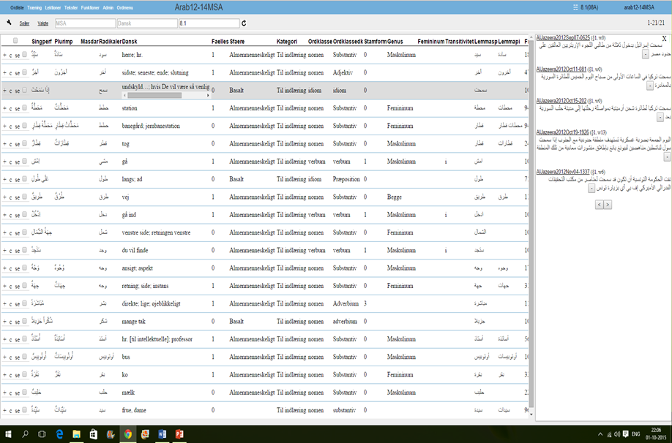
BILC SEMINAR
Challenges and solutions
Word list management – teacher and student
Database solution:
Online words and word lists
Infinite possibilities for labeling words
Auto-generation of word lists
Integration with flashcard app
Notes:
Slide 3 / challenges and solutions
At the Department of Languages and Cultures, we have faced a number of challenges regarding word lists and vocabulary training. This especially regarding our intensive military linguist courses in Arabic, Russian and Dari. These courses train linguist from level 0 up to – or aiming at – level 3 over a period of 20 month. Since we train our military linguists also as translators and interpreters, we rely heavily on the classic format of word lists – with translation or approximate translation of words into the target language. Also, at our courses we work with the full range of vocabulary from basic greetings to military technical terminology.
Word list management – teacher and student
These courses are highly intensive requiring our students to learn up to as much as 150 words/glosses a week. When producing new teaching materials or at later stages, bringing in current news items or current military orders into class, you always face the question of whether - or how - to gloss. Altogether, it adds up to quite a few word lists and how do you keep track of progression and how do you avoid not over- or under-glossing a new text.
The challenge is of course also on our students, they have to acquire a lot of vocabulary. How do they keep track of progression, and how do they look up words, which they have been taught and then might have forgotten. And how do they find additional information about a given word without resorting to dictionaries or simple googling. In addition, what if they are unsure about the pronunciation of a word.
Database solution
We have organized all words and word list into a database. It’s programmed by language teachers and based on PHP and MySQL. Design and layout needs improvement, but functionality is high. Developed over the last five years, well tested.
Online words and word lists
All words given on word lists during the course is entered in the database and assigned a word list corresponding to a specific lesson number or specific text. Words can be removed, added, assigned to other lessons and order of word lists can be manipulated. The database contains many words not necessarily on a word list, so it also functions as a primitive dictionary. All is online.
Infinite possibilities for labeling words.
It is a database so you can always add a new field or column with information about the word for instance: sound, picture, grammatical notes, word class, target language definition, use in context, frequency, translation into other languages.
Auto-generation of word lists
Do you want to try a new text in class, but not sure how to gloss it? The database will compare the text to the progression of the course and mark all words not previously glossed. You can then decide which of them should be in a word list, which is then automatically generated. This greatly reduces the redundancy we experienced earlier, where you found yourself rewriting or copy pasting words from different word lists
Integration with flash card app
All word lists can be downloaded including sound and pictures on a commercial app, (we use flash card deluxe) for repetition and review. The online flash cards have up to 4 sides, and each side can have more than one column or field of information on them. So for a certain part of the course you might want sound, translation and transcription in Latin letters, but later you would want to skip the transcription, but include the target language definition

Slide 12
NATO task verbs in RDMA English classes (STANAG 2287 ed 1)
Three aims:
- introduce, practice, and consolidate essential orders terminology
- increase awareness of NATO task verbs vs national lexicons
- complement reading and understanding of UK/US army FMs

Slide 13
STANAG 2287 ed 1
Used during English ”combat” classes.
Focus on kinetic tasks and effects.
STANAG 2287 ed 2 introduced late in intermediate course, during ”stability” classes.

Slide 14
Game specifications
Intended users: Army cadets and intermediate-course students at the Royal Danish Military Academy.
Used in connection with scheduled classes as well as distance-learning and self-study sessions.
10, 20, or 48 questions.
Scoring: Sliding scale e 5, 3, 1 points depending on number of clues needed. 1 point for each bonus question. High score registered.
UK and US pronunciation.
Spelling: ATTACK, Attack, attack ☺ atack ☹
Initial meta-instruction in Danish. Otherwise in English.

Slide 15
The task-verb game
http://www.fels.dk/spil/

Slide 16
English/Danish nomenclature
Intended users: All army personnel.
It is a word list; NOT a dictionary.
Authorized terms (authentic NS FMs, glossaries, directives etc.)
NOT ”this is what we said on Team 10 in Iraq, I think”.
Predominantly UK and US; some NATO, a wee bit CAN.
Words with several context-dependent meanings (1), (2), (3)…..
Commands!
PRO WORDS

Slide 17
Army tactical terms
http://dfo.fels.dk/

Slide 18
A battle of words
developing a naval battle quiz
http://quizspil.fels.dk/

Slide 19
Project goals
build and retain core professional vocabulary among naval professionals
enable and encourage informal language learning outside formal training/education system currently in place in the Danish Defence/Navy
expand and consolidate general knowledge of naval culture and history

Slide 20
The case for vocabulary
English is the (operational) language at sea and in NATO;
currently no structured maintenance/acquisition of vocabulary in RDN post Basic Officer Training;
as fluency and ability to express oneself in L2 grows, so does the need for productive vocabulary knowledge.

Slide 21
Vocabulary learning
Focus is on semantics
Input: L2 definition of words, phrases, acronyms, events etc. (audio/writing)
Processing: map definition onto word form
Output: game draws on receptive skills - reading and listening to work out meaning of vocabulary items.
‘acquisition of a word’s semantic and conceptual properties, and the mapping of word form labels onto meaning representations, result from conscious (or explict) learning processes.’ (Ellis, 1997)
Notes:
some morphological and phonological input, scant stylistic and contextual input (not inference from context)

Slide 22
Vocabulary learning cont’d
Knowledge of does not equate mastery but evidence to suggest that recurrent exposure to vocabulary (albeit in varying contexts) is instrumental in promoting storage, retention and retrieval of lexical items that make up the mental lexicon (semantic networks).

Slide 23
How about the learner?
material/content of direct relevance to profession, job in hand, culture;
appeals to competitive/gaming streak;
spaced retrieval/retrieval practice – ties in well with research on vocabulary acquisition (Ellis);
easy to access and use across platforms/devices.

Slide 24
Serious gaming
’the addition of elements commonly associated with games…to an educational or training program in order to make the learning process more engaging’ (Landers & Callan, 2011).

